Slide 1
Adv. Machine Learning Project Skin Cancer Classification Muhammad Dawood Hamayun

Slide 2
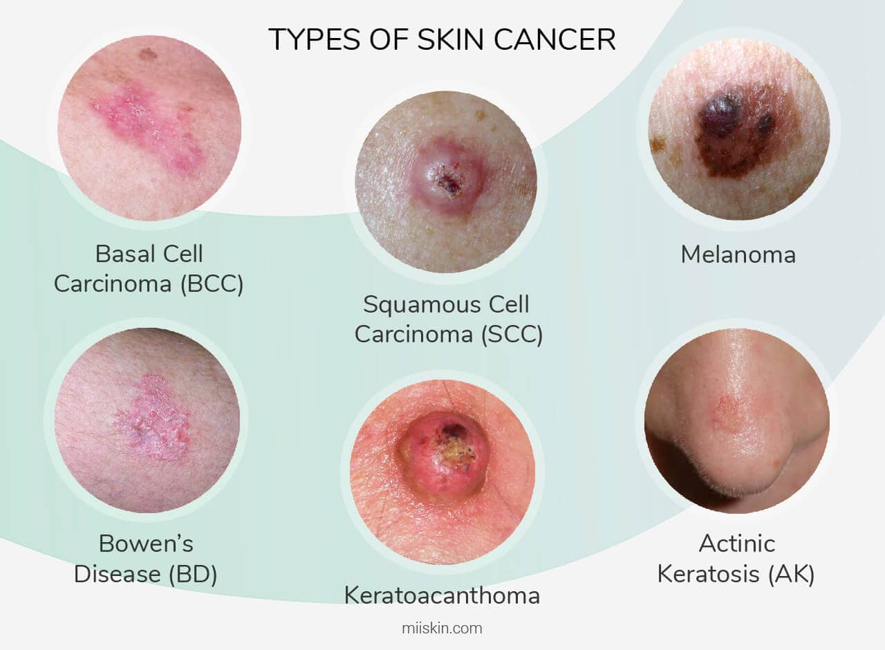
Project Description
Images can be divided into 8 distinct classes:
Actinic keratosis (AK),
intraepithelial carcinoma / Bowen’s disease (akiec), basal cell carcinoma (BCC),
benign keratosis-like lesions (solar lentigines / seborrheic keratoses and lichen-planus like keratosis) (BKL),
dermatofibroma (DF),
melanoma (MEL),
melanocytic nevi (NV)
Squamous Cell Carcinoma (SCC)
vascular lesions (angiomas, angiokeratomas, pyogenic granulomas and hemorrhage, VASC)

Slide 3
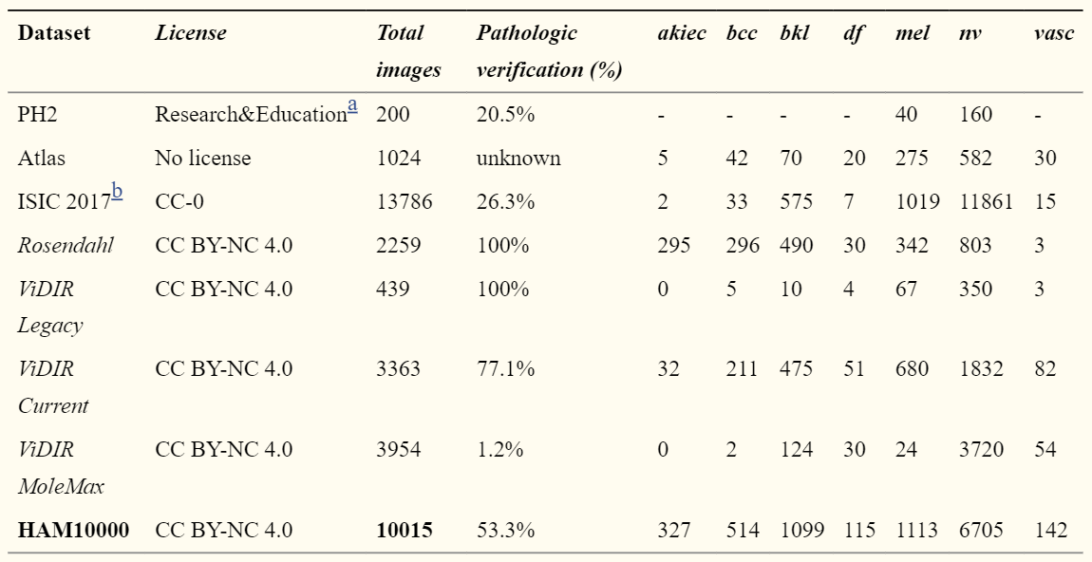
Dataset Exploration
Dataset selected for the project is HAM10000 because of the extended number of images for the
transfer learning techniques
Dataset Link: https://dataverse.harvard.edu/dataset.xhtml?persistentId=doi:10.7910/DVN/DBW86T
ª Not stated specifically on the providing website, we infer their given terms-of-use largely reflect CC BY-NC-ND 3.0
^{b} Eight different datasets with CC-0 licensing combined as available on February 12th 2018.

Slide 4
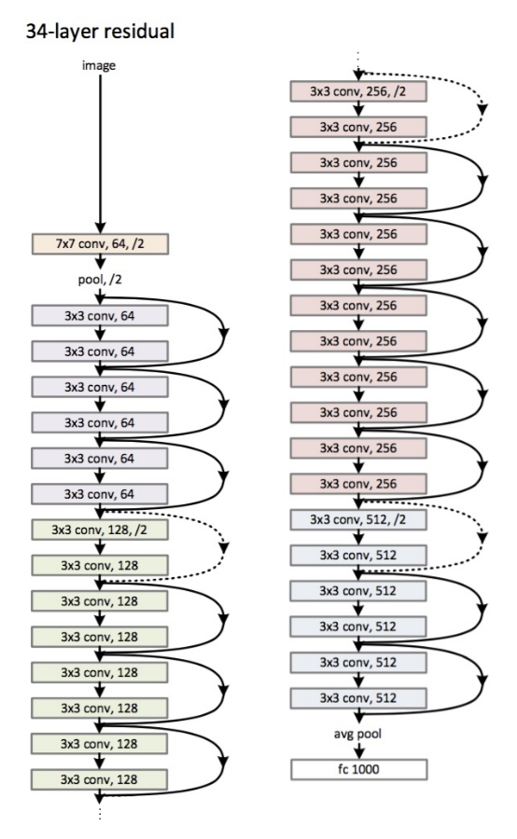
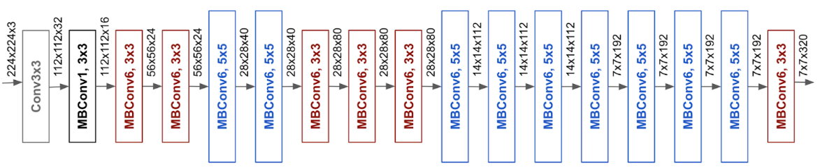
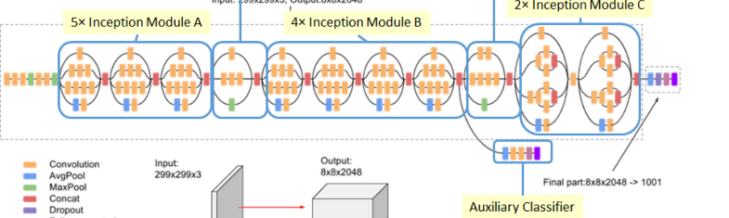
Pre Trained Models
Efficent Net B7
https://keras.io/api/applications/efficientnet/#efficientnetb7-function
Resnet 152
https://keras.io/api/applications/resnet/#resnet152v2-function
Inception V3
https://gist.github.com/neggert/f8b86d001a367aa7dde1ab6b587246b5
NASNet Large
https://keras.io/api/applications/nasnet/#nasnetlarge-function
EfficentNet B7 Architecture
Resnet 152 Architecture
InceptionV3 Architecture

Slide 5
Focus!
Use the Pretrained Models from the below list to identify the image from 8 given Class of cancer
1. EfficientNet
2. NASNetLarge 3. NASNetMobile 4. MobileNet 5. InceptionResNetV2 6. Resnet152
Required:
Notebook
Model Accuracy

Slide 6
Agenda
Create two different models using 2 different transfer learning architectures in order to classify from 8 different categories of skin cancer.
The techniques required for achieving such model was:
Load, resize (224x224), and label given dataset.
Image preprocessing (includes image normalization).
Applied one-hot encoding to labels.
Use Transfer Learning to take specified pre-trained model.
Added hidden layers, with Dropout and BatchNormalization.
Train both models.
Visually Plot the Model’s Performance (Optional).
Create a Classification Report and Confusion Matrix for both models.

Slide 7
Problem Statement and Assumptions
Used 2 different models in order to classify 8 cancer classes from a reduced dataset as the complete dataset would take a lot of time and resource.
Due to the reduced dataset, I believe ResNet152’s large and complex architecture gave low accuracy results. Furthermore, I think it can be fixed by simply increasing the size of dataset, or applying techniques like Image Augmentation (If possible).

Slide 8
Data Preprocessing Steps
For Preprocessing, the following techniques were implemented:
Images were converted to an array
Images were then converted to float32 data type
Applied normalization process by dividing images by 255.
Achieved the image data shape (1402, 224, 224, 3).

Slide 9
Feature Engineering and Feature Selection
Both models gave the following feature vector after applying Flatten() in the end:
MobileNet = 5,0176
ResNet152= 10,0352

Slide 10
Model used for Modeling
The 2 different models which were used for the project were:
ResNet152
MobileNet

Slide 11
Results and Improvement
The Following results were achieved by both models:
ResNet152 = 33.45%
MobileNet = 75.801%

